Slide 1
GRAPHS
A-Z

Slide 2
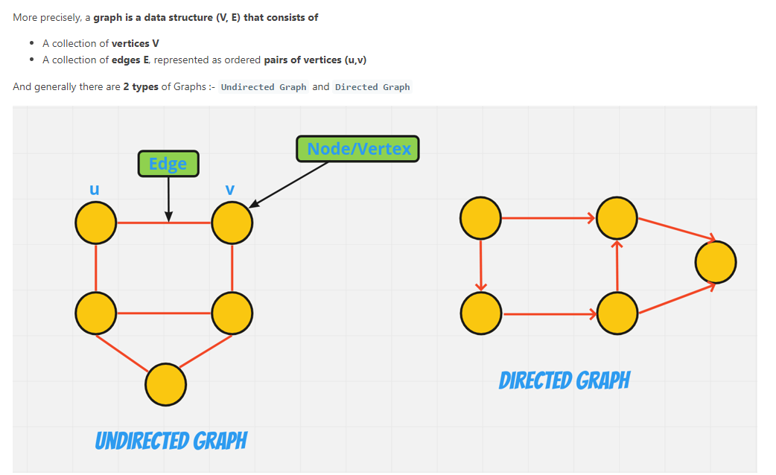

Slide 3
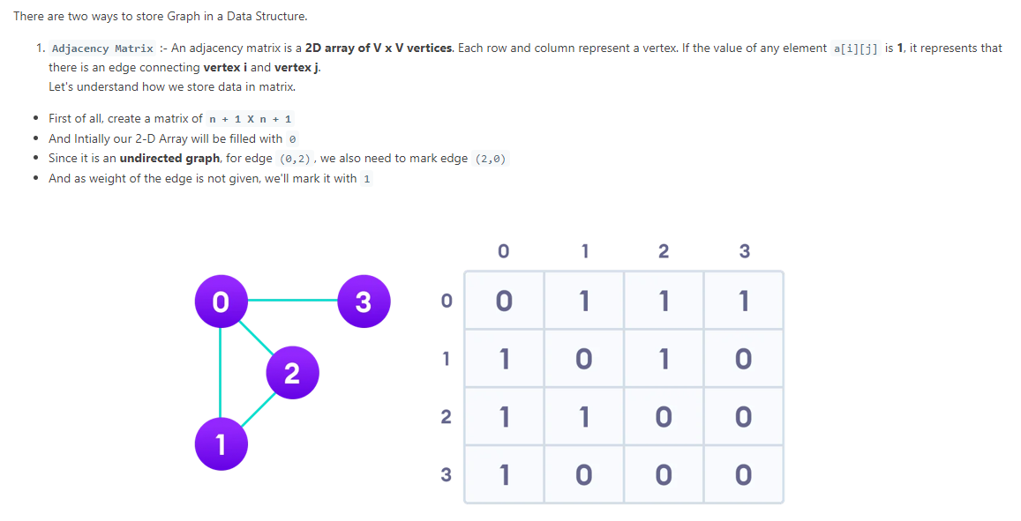

Slide 4
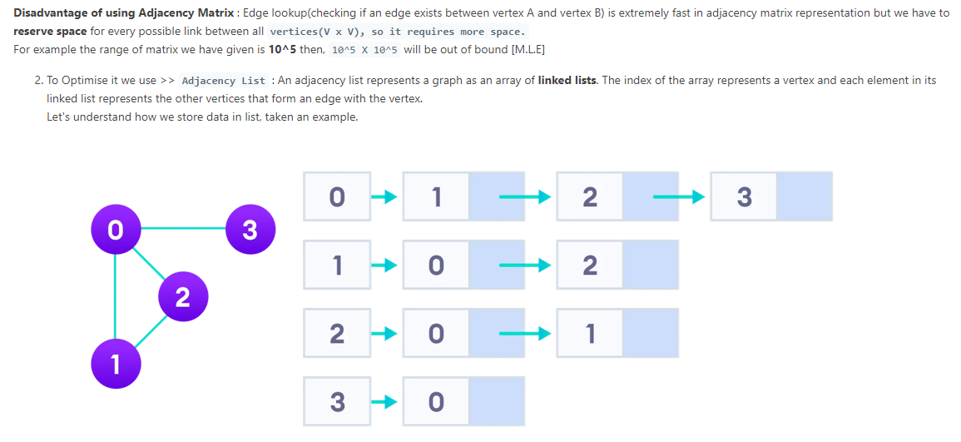

Slide 5
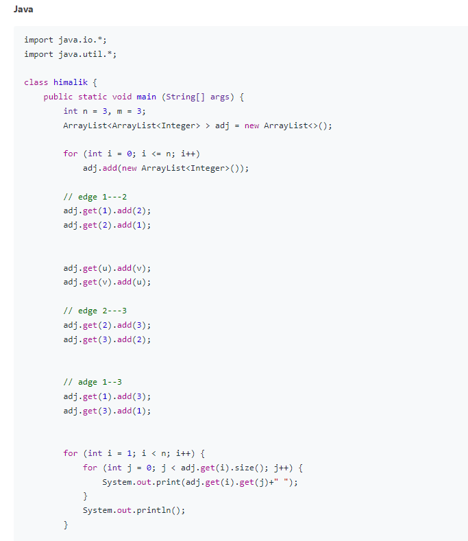

Slide 6
LEETCODE ARTICLES
https://leetcode.com/discuss/general-discussion/655708/Graph-For-Beginners-Problems-or-Pattern-or-Sample-Solutions
https://leetcode.com/discuss/study-guide/2360573/Become-Master-In-Graph

Slide 7
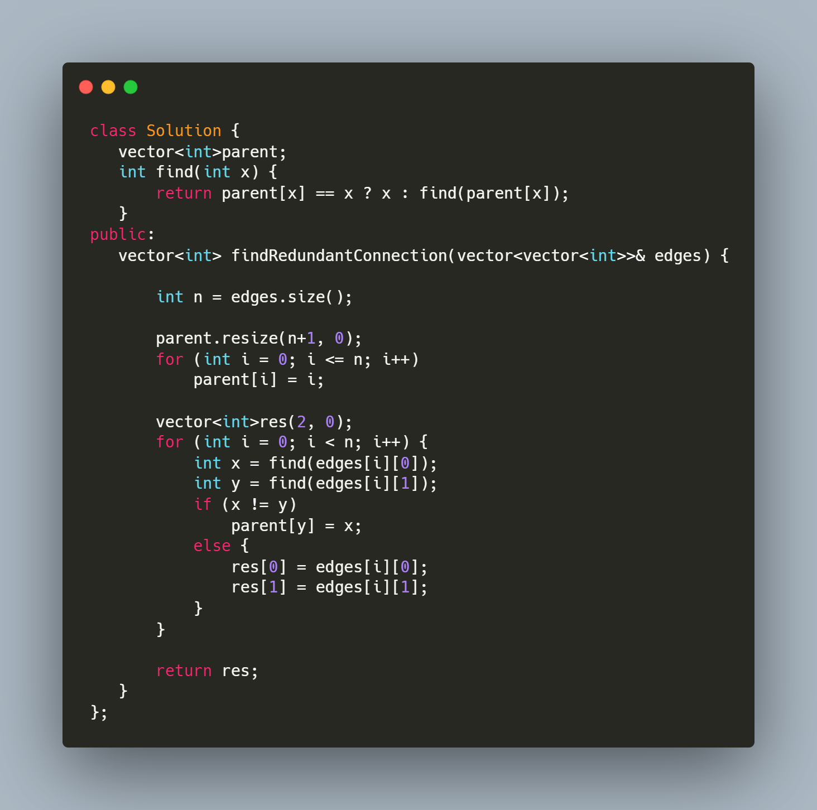
UNION FIND
Union Find:
Identify if problems talks about finding groups or components.
https://leetcode.com/problems/friend-circles/ https://leetcode.com/problems/redundant-connection/ https://leetcode.com/problems/most-stones-removed-with-same-row-or-column/ https://leetcode.com/problems/number-of-operations-to-make-network-connected/ https://leetcode.com/problems/satisfiability-of-equality-equations/ https://leetcode.com/problems/accounts-merge/

Slide 8
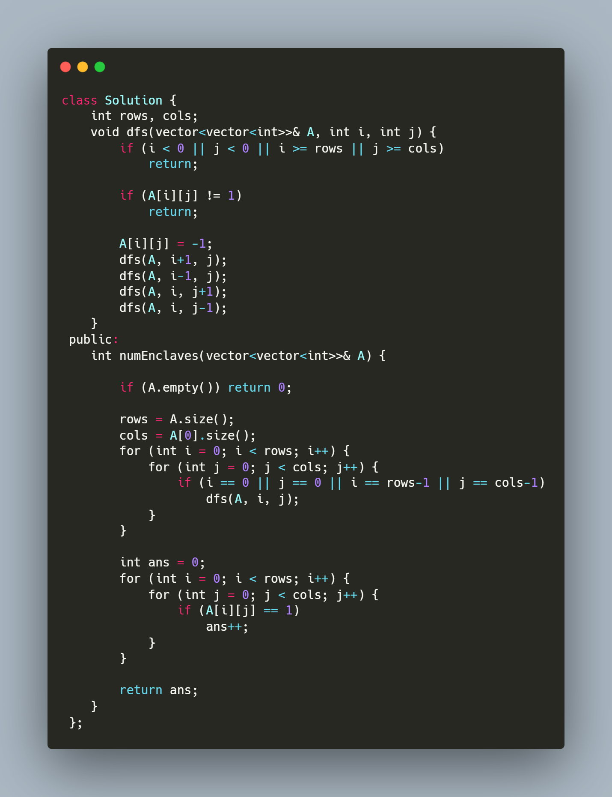
DFS
Start DFS from nodes at boundary:
https://leetcode.com/problems/surrounded-regions/
https://leetcode.com/problems/number-of-enclaves/

Slide 9
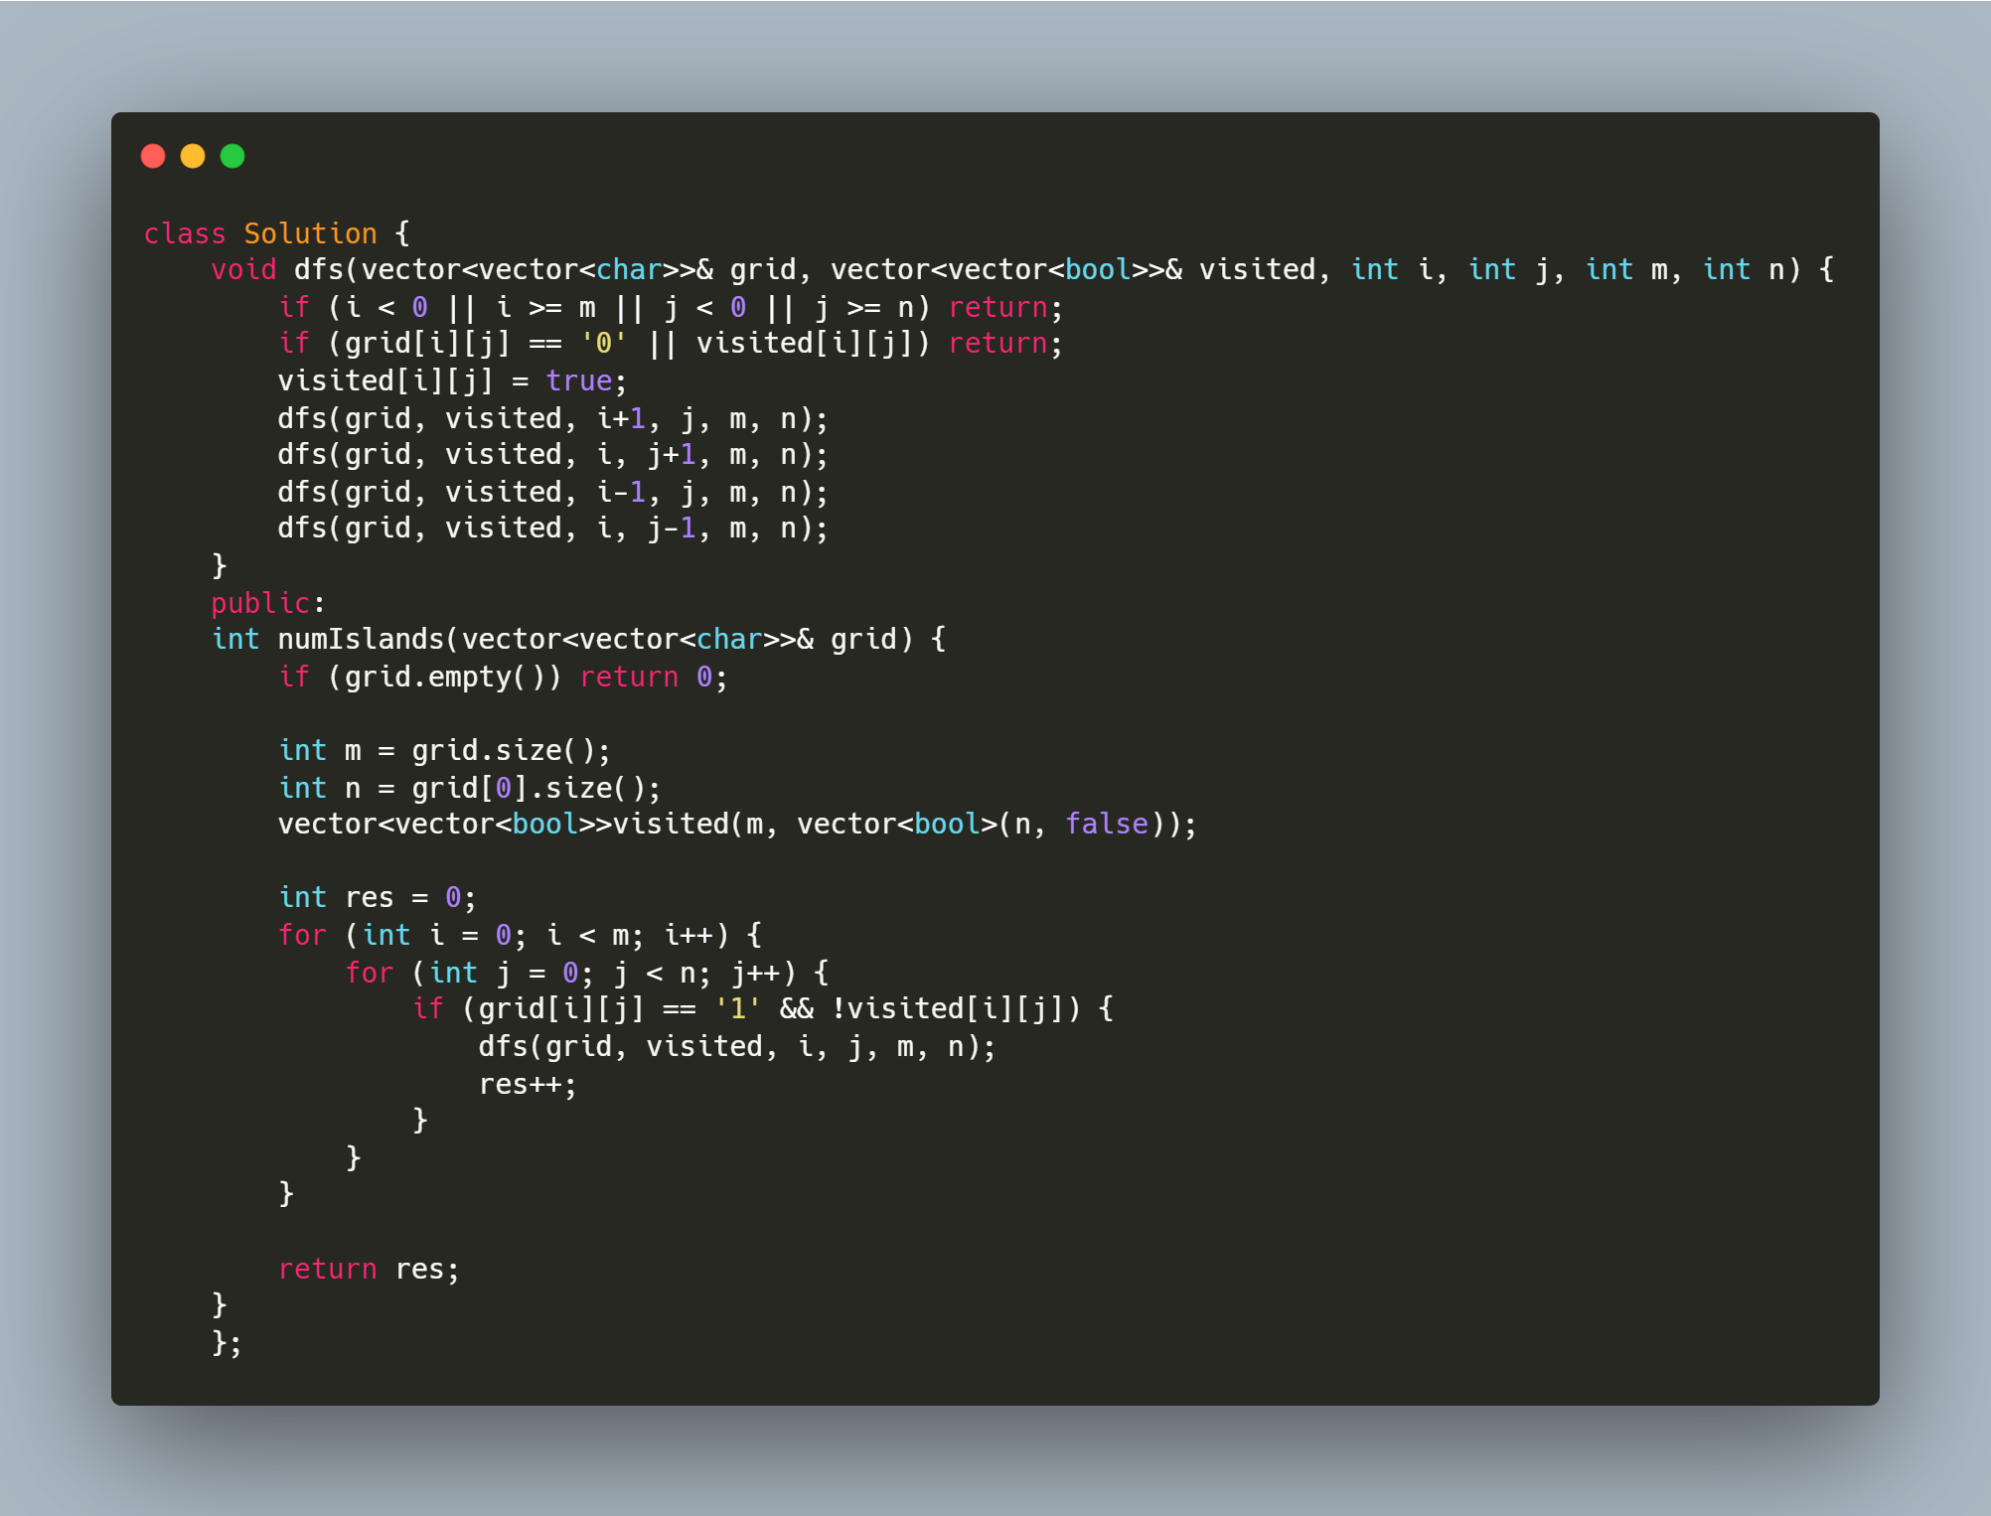
DFS PART 2
DFS from each unvisited node/Island problems
https://leetcode.com/problems/number-of-closed-islands/
https://leetcode.com/problems/number-of-islands/
https://leetcode.com/problems/keys-and-rooms/
https://leetcode.com/problems/max-area-of-island/
https://leetcode.com/problems/flood-fill/

Slide 10
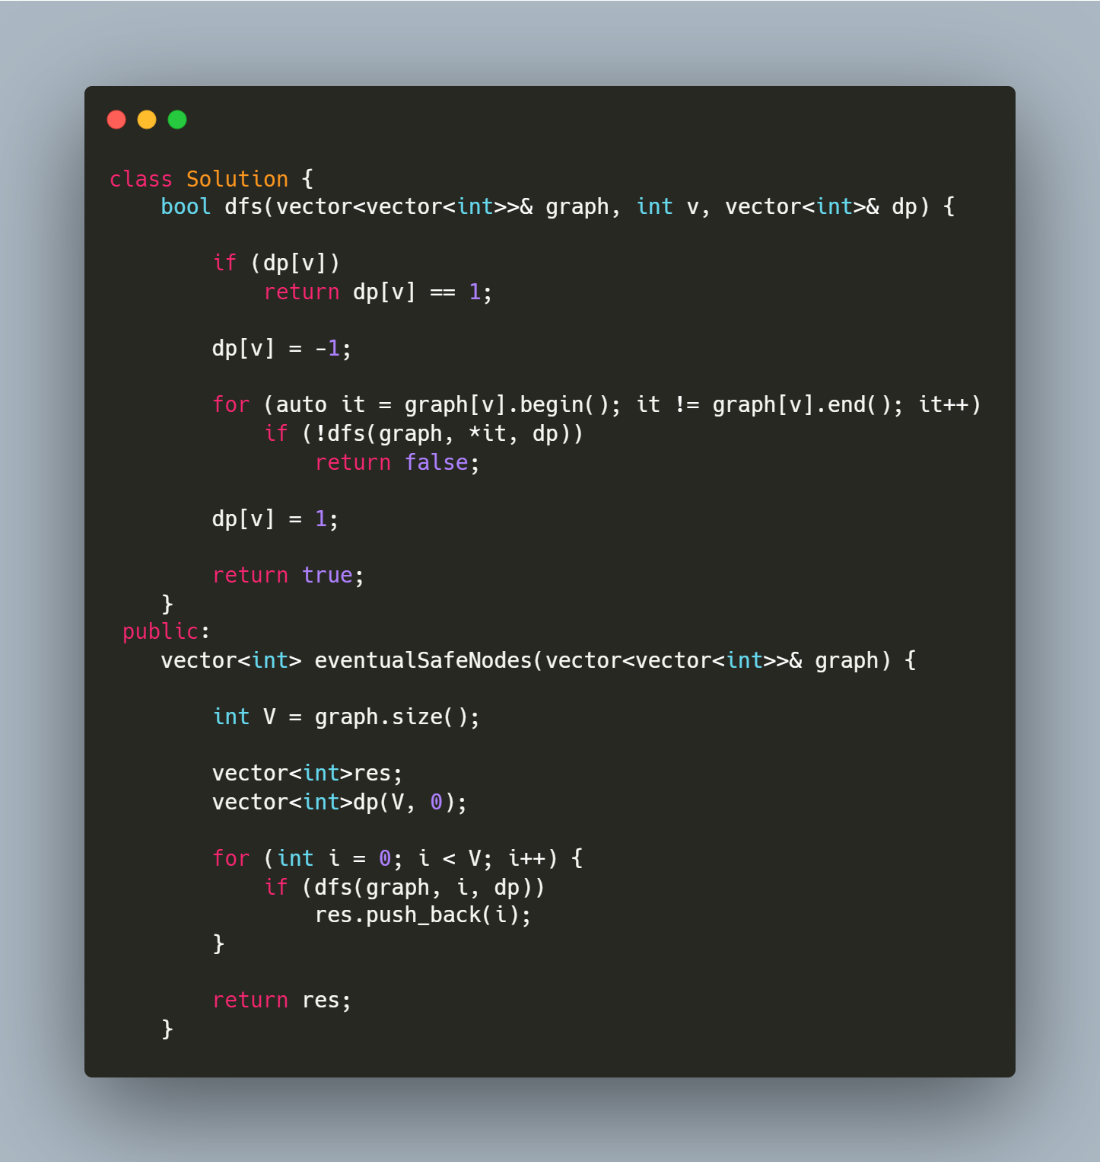
CYCLE FINDING

Slide 11
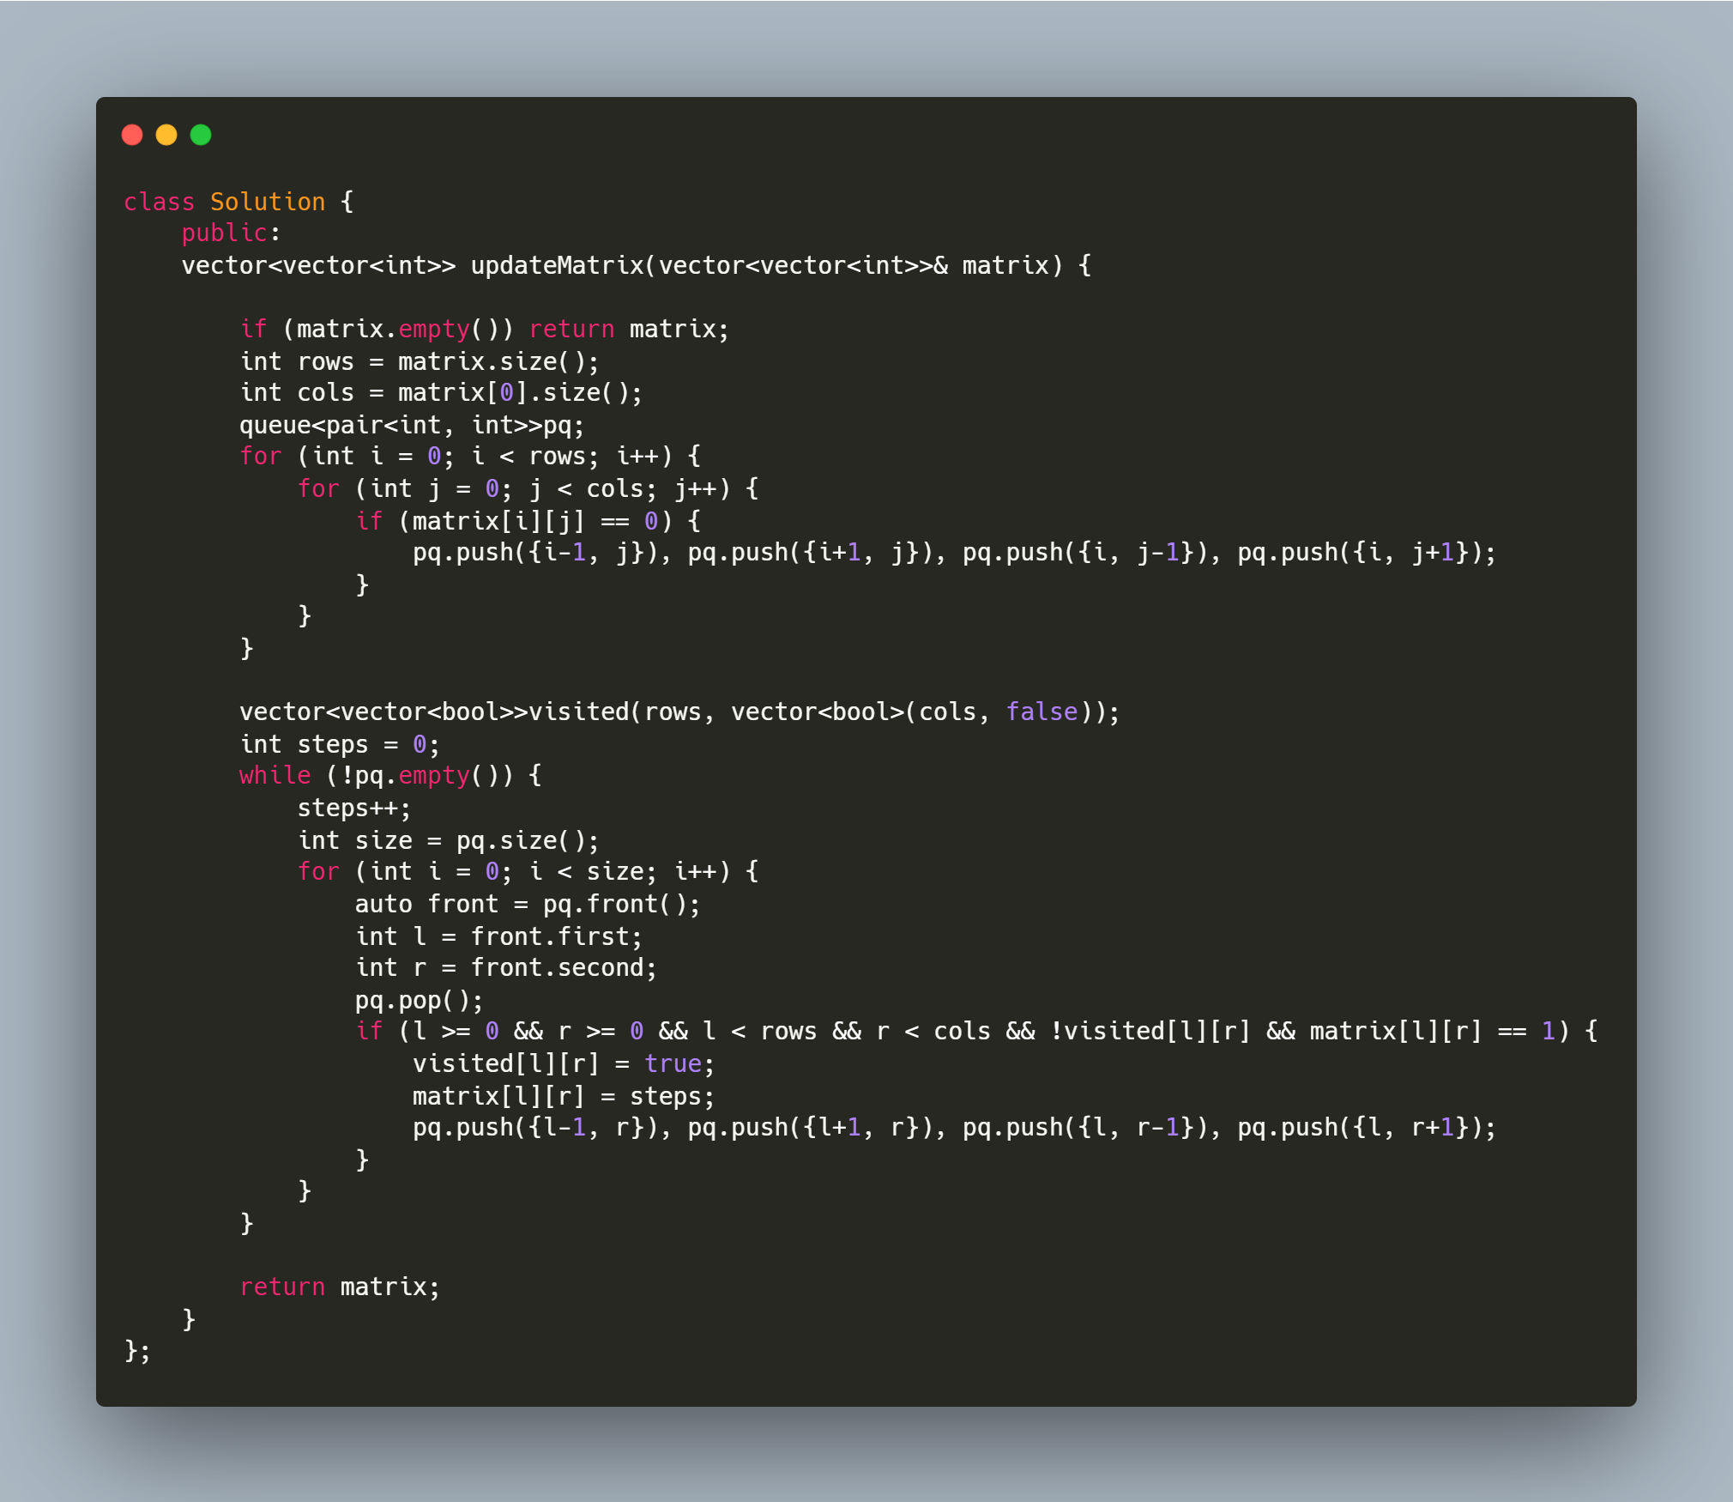
Breadth First Search
Shortest Path: https://leetcode.com/problems/01-matrix/ https://leetcode.com/problems/as-far-from-land-as-possible/ https://leetcode.com/problems/rotting-oranges/ https://leetcode.com/problems/shortest-path-in-binary-matrix/

Slide 12
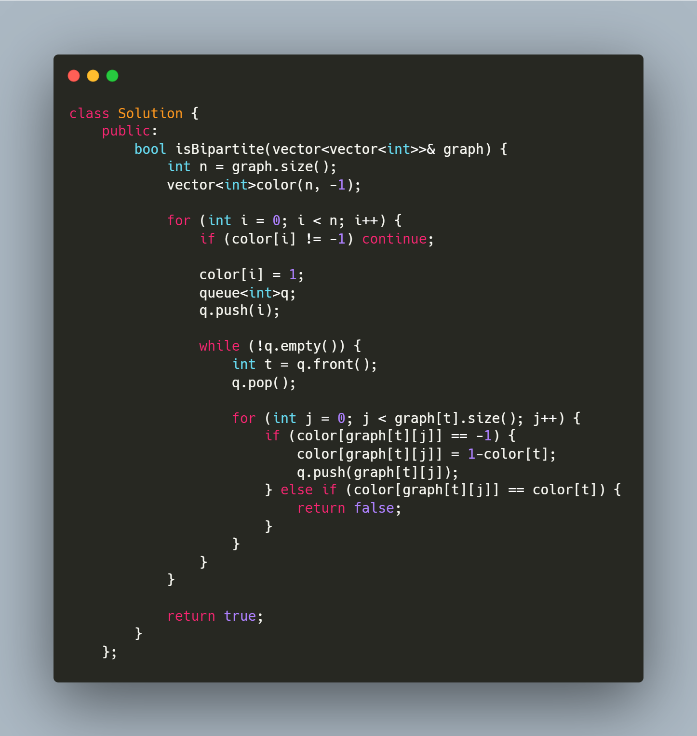
GRAPH COLORING
Graph coloring/Bipartition https://leetcode.com/problems/possible-bipartition/ https://leetcode.com/problems/is-graph-bipartite/
Problems asks to check if its possible to divide the graph nodes into 2 groups Apply BFS for same. Below is a sample graph coloring approach.

Slide 13
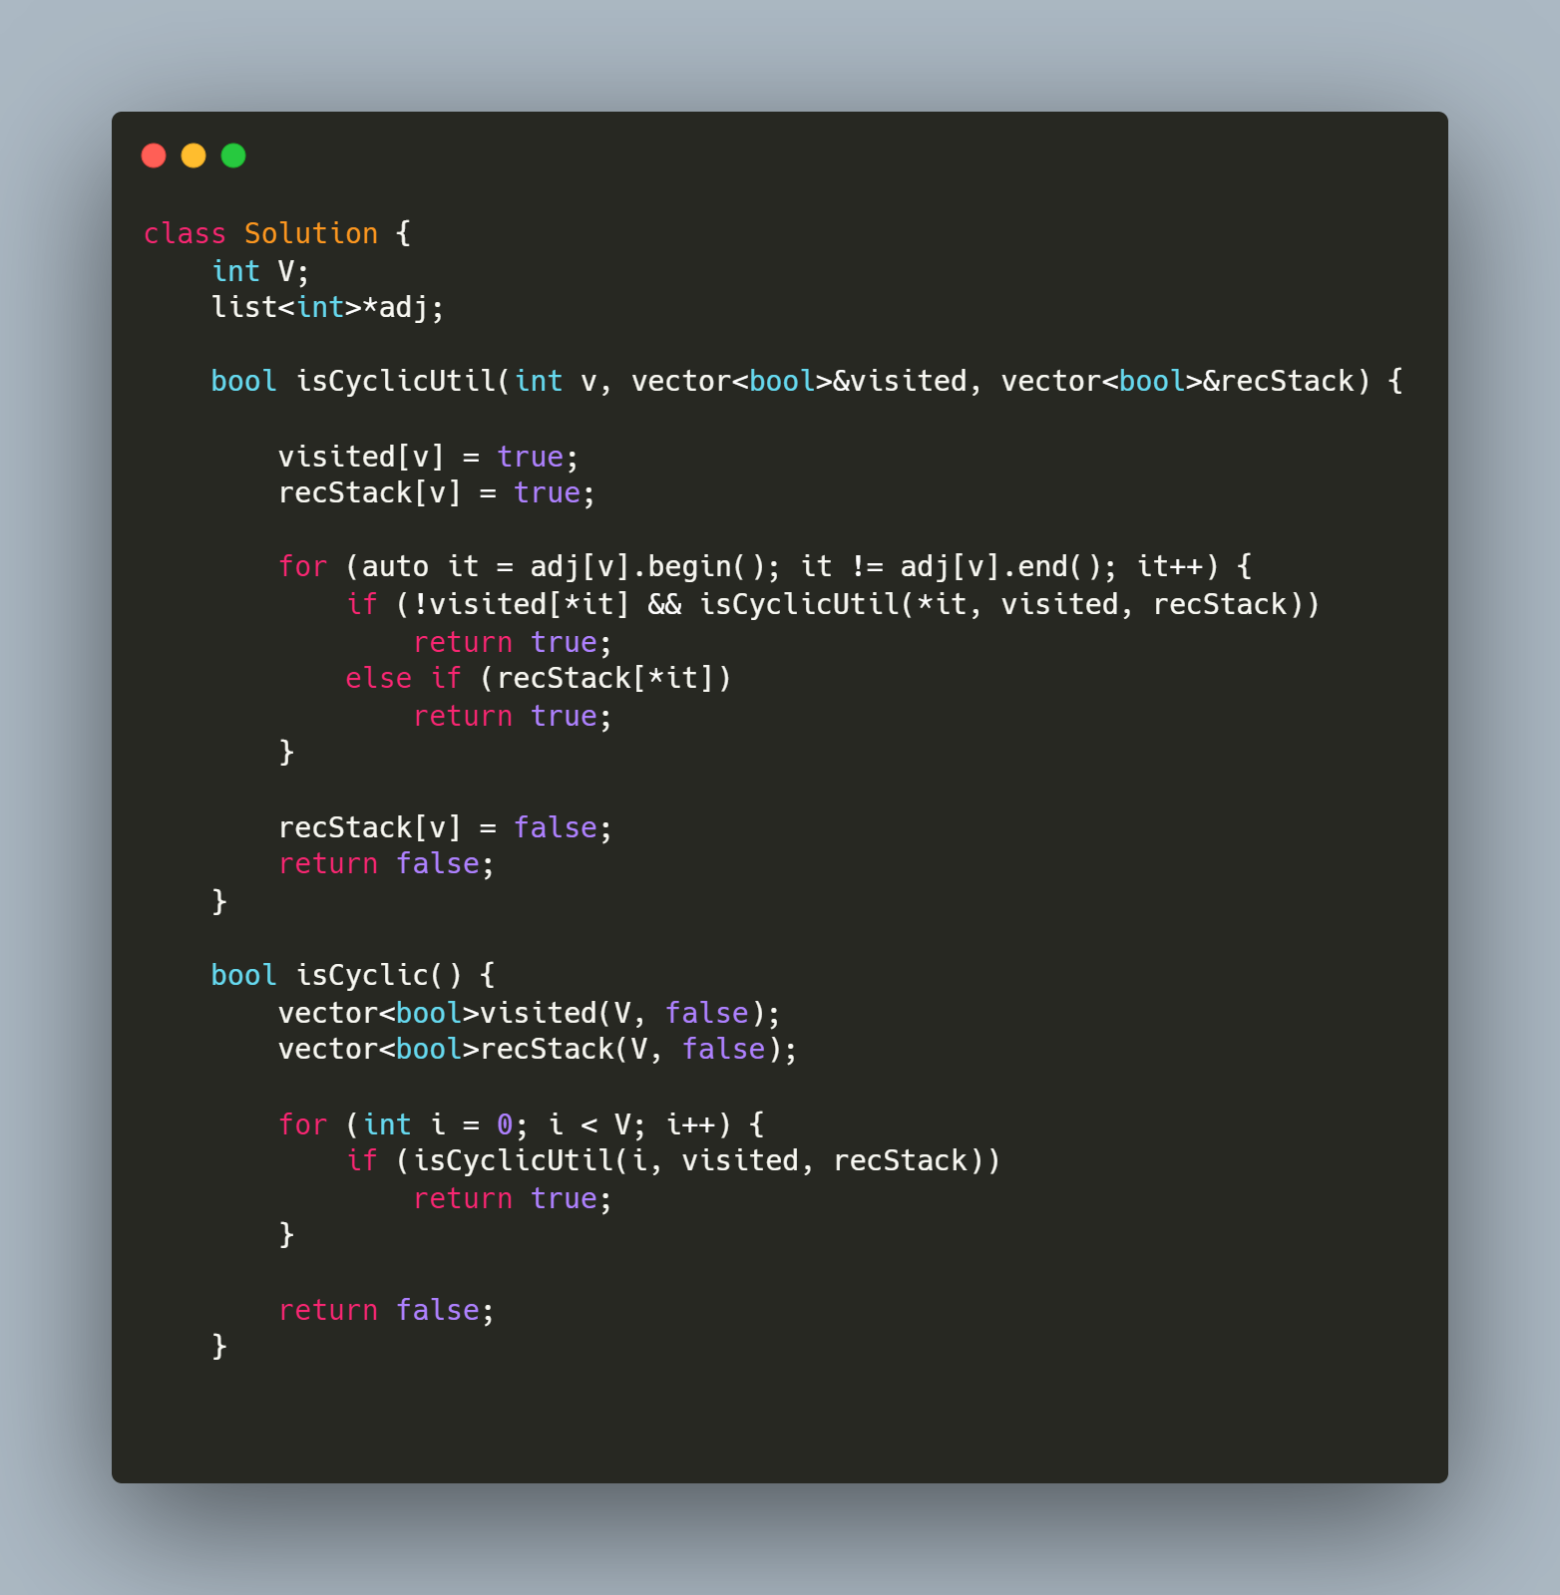
TOPO SORTING
Topological Sort: Check if its directed acyclic graph and we have to arrange the elements in an order in which we need to select the most independent node at first. Number of in-node 0
https://leetcode.com/problems/course-schedule/ https://leetcode.com/problems/course-schedule-ii/

Slide 14
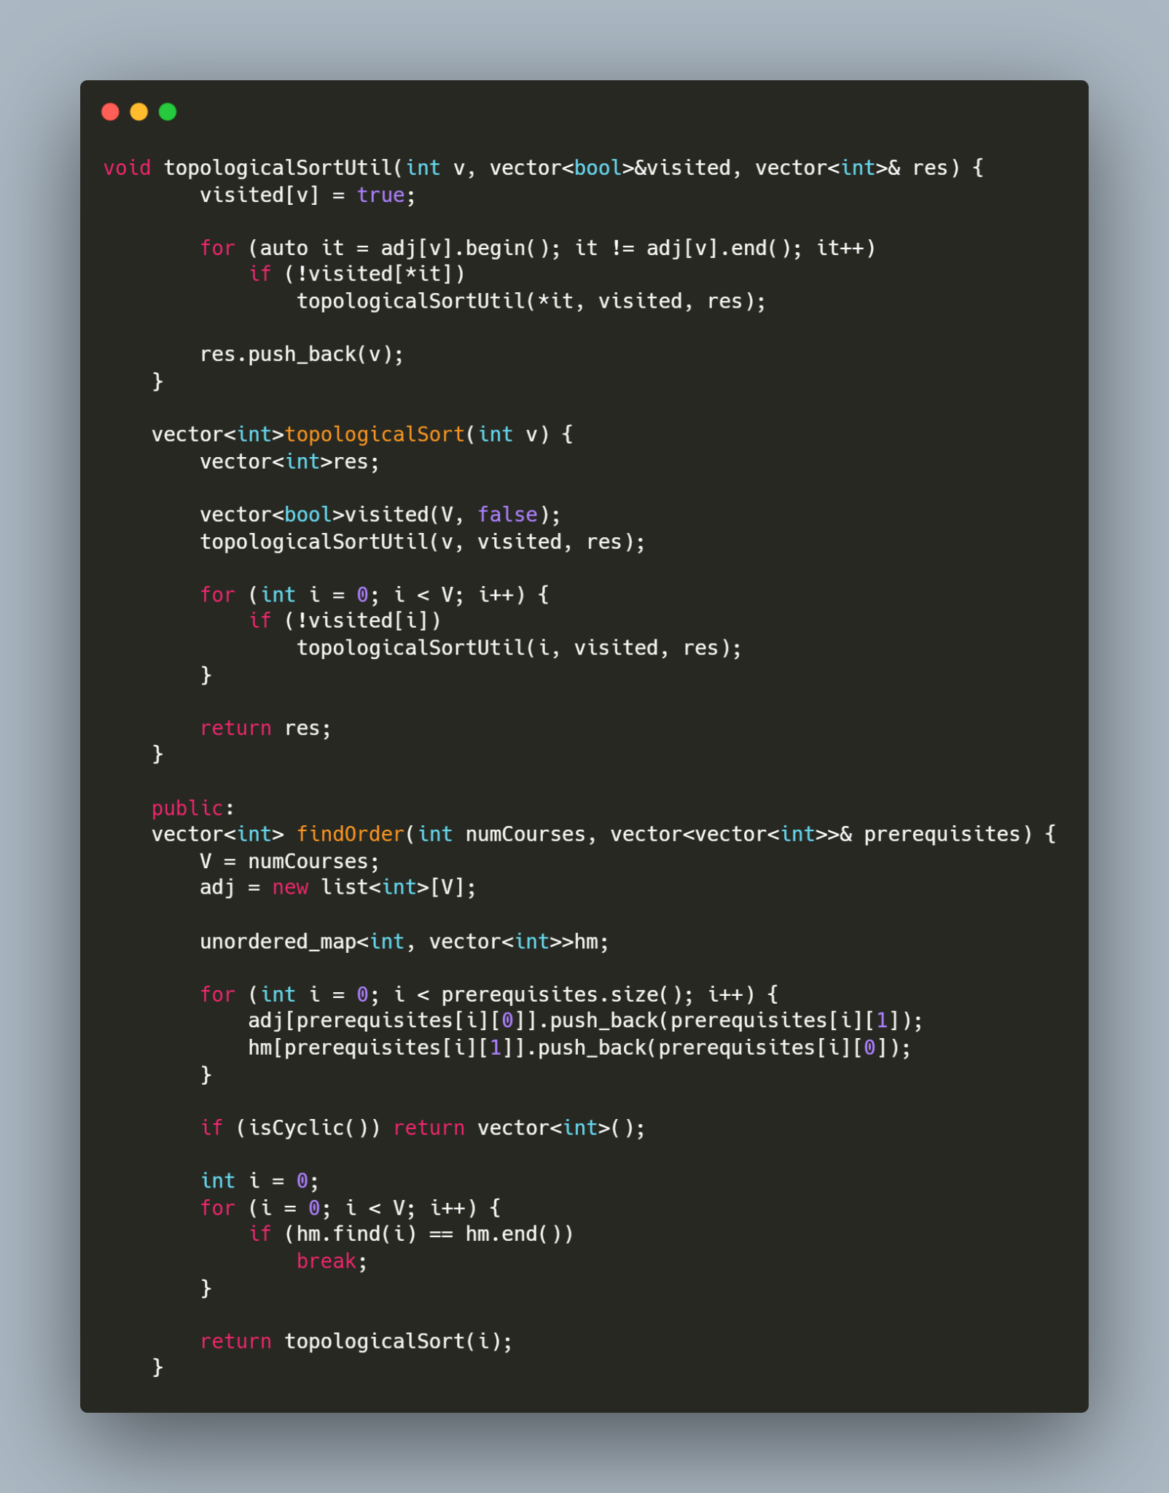
TOPO SORTING PART 2

Slide 15
DFS - Iterative and recursive solutions

Slide 16
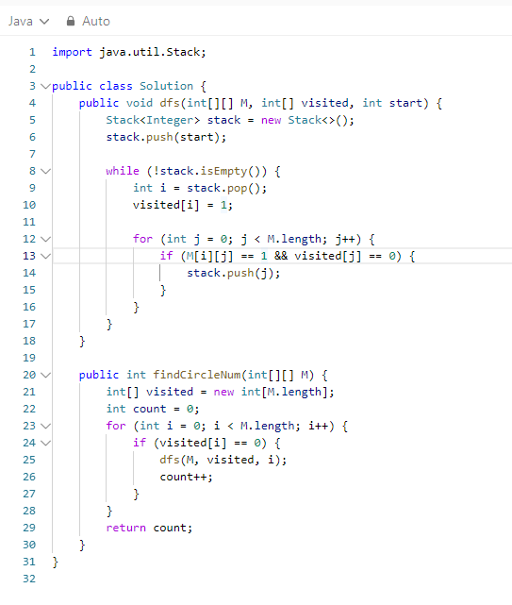
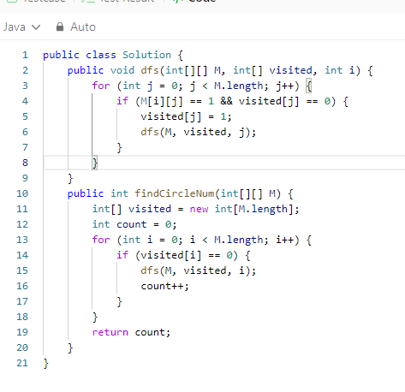

Slide 17
LEETCODE ARTICLES
https://leetcode.com/discuss/general-discussion/655708/Graph-For-Beginners-Problems-or-Pattern-or-Sample-Solutions
https://leetcode.com/discuss/study-guide/2360573/Become-Master-In-Graph

